Slide 1
Exploratory Data Analysis of NYC Yellow Taxi Trip Records (2020)
Sajan Singh Shergill
Shah Jay Sandipkumar
Dixit Ruturaj Makarand

Slide 2
Project Overview: understanding the nyc taxi trip data
Context & Purpose:
The project focuses on Exploratory Data Analysis (EDA) of NYC Yellow Taxi Trip Records for 2020, using datasets from the New York City Taxi & Limousine Commission (TLC).
We are expected to perform a comprehensive EDA to identify data issues, patterns, and correlations that impact ride-time predictions.
The analysis prepares data that can later be fed into a Deep Learning model for trip duration estimation.
Primary Objective:
To discover statistical relationships among variables and understand how factors such as pickup time, distance, and passenger count influence trip duration.
Tools & Libraries:
Pandas / Numpy – Classic EDA and data manipulation
TensorFlow Data Validation (TFDV) – Statistical data profiling
Apache Beam & GraphViz – Pipeline processing and graphical summaries
Dataset Month | Purpose in Pipeline
March 2020 | Training Dataset
May 2020 | Evaluation Dataset

Slide 3
DATASET DESCRIPTION & STRUCTURE
Dataset Source:
NYC Taxi & Limousine Commission (TLC) — Yellow Cab Trip Records for 2020
https://www1.nyc.gov/site/tlc/about/tlc-trip-record-data.page
Files Used for Analysis:
Key Columns:
pickup_datetime, dropoff_datetime ->> time-based features
passenger_count, trip_distance, fair_amount
Pickup_longitude, pickup_latitude, dropoff_longitude, dropoff_latitude
Payment_type, RateCodeID, VendorID
Month | Purpose | Format
January 2020 | (Optional Baseline – Pre-COVID) | Parquet
March 2020 | Training Dataset | Parquet
May 2020 | Evaluation Dataset | Parquet
Target Variable (Analytical Focus) = Dropoff_datetime – pickup_datetime

Slide 4
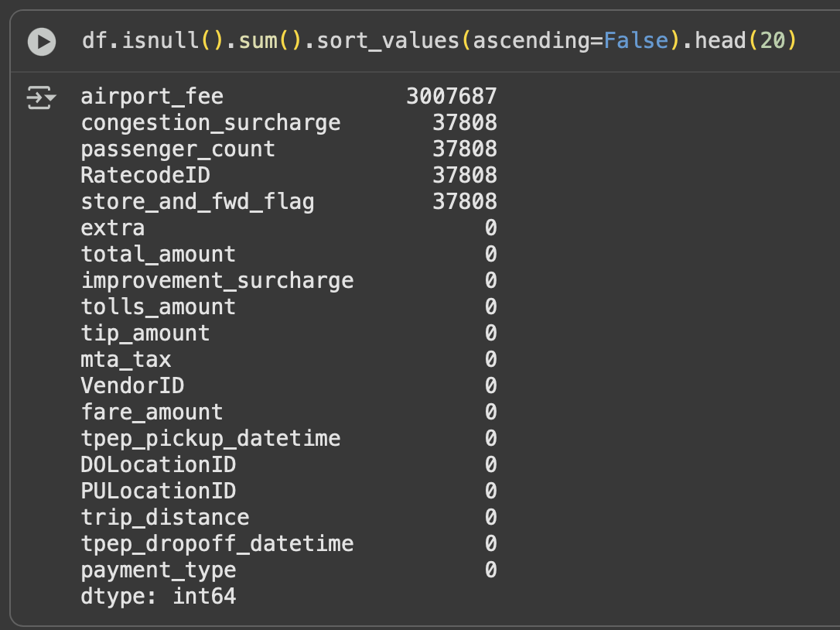
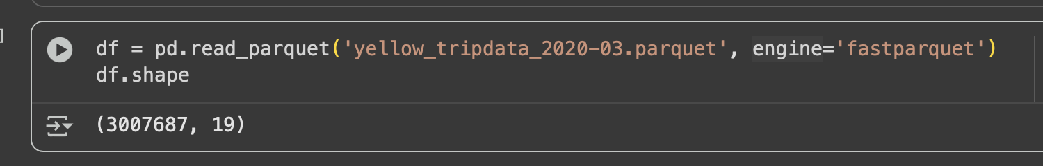
Data Preparation & Cleaning
Data Loading
Dataset imported from the TLC Parquet files using
“pandas.read_parquet('yellow_tripdata_2020-03.parquet', engine='fastparquet’)”
Verified schema (17 columns) and data types for consistency.
Handling Missing & Invalid Values
Used df.isnull().sum() to identify null entries in pickup_datetime, dropoff_datetime, and RatecodeID.
Dropped records missing timestamps (critical to compute trip duration).
Imputed categorical fields (RatecodeID, payment_type) using mode imputation.

Slide 5
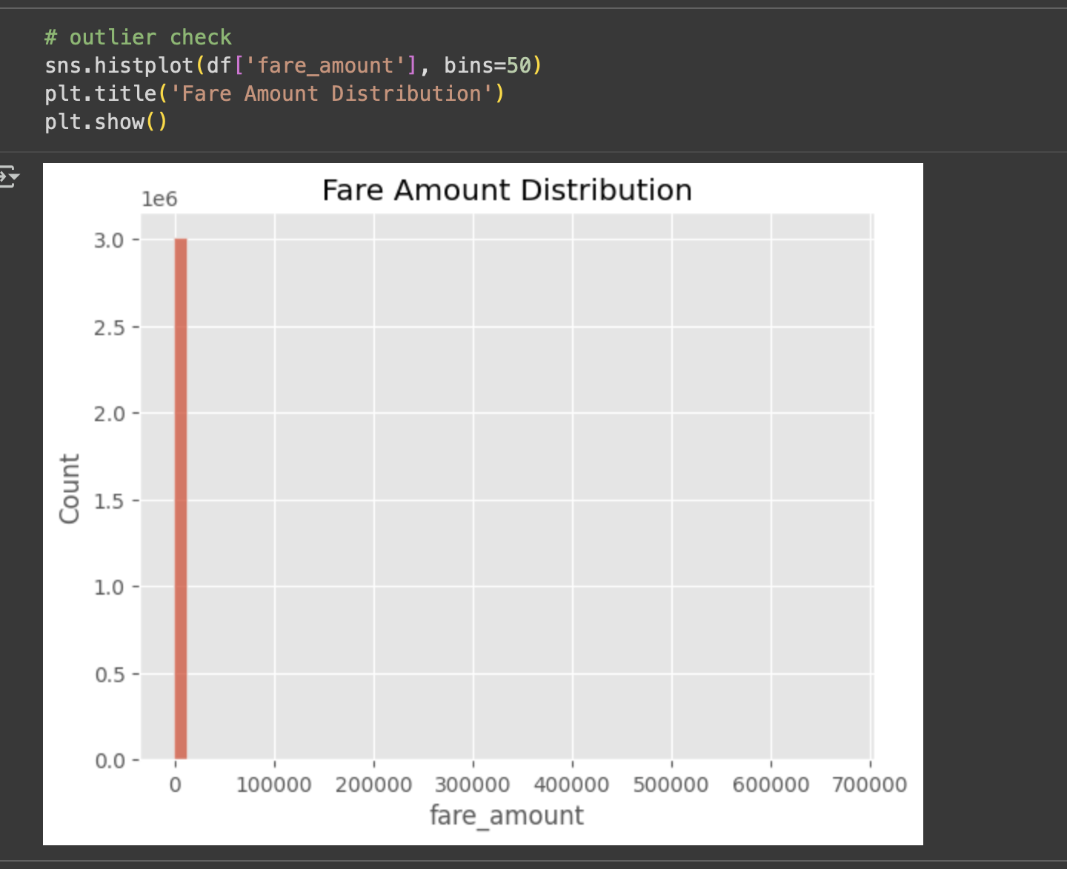
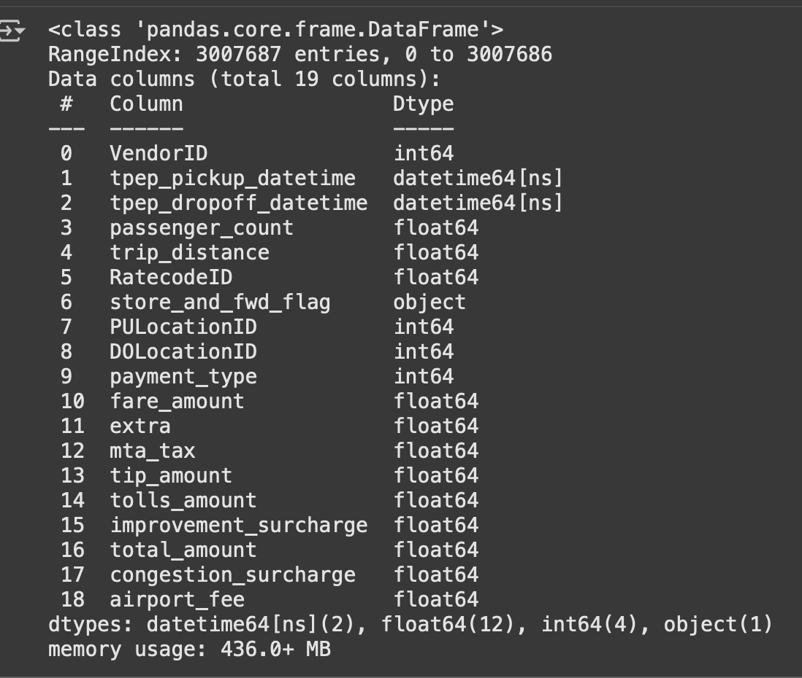
Outlier Detection & Treatment
Removed trips with:
trip_distance <= 0 or > 50miles
Fare_amount <= 0 or > 200USD
Eliminated inconsistent or duplicate entries based on trip identifiers.
These filters ensured only realistic travel records remained for analysis.
Feature Transformation
Converted datetime fields to datetime64 format.
Derived target feature trip_duration = (dropoff – pickup).total_seconds()
Encoded categorical variables (VendorID, payment_type) as numerical labels.
Ensured all model-ready features are numeric and standardized.

Slide 6
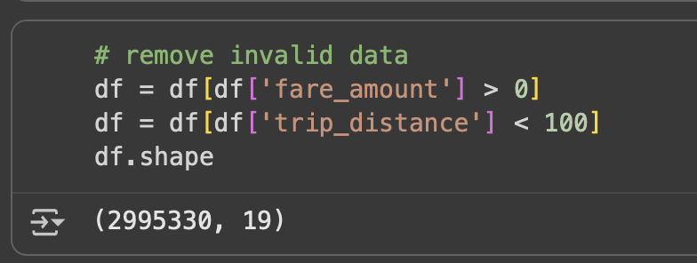
Quality Verification (TFDV)
Employed TensorFlow Data Validation to generate statistical summaries.
Validated schema and confirmed absence of missing or extreme anomalies post-cleaning.
Outcome
Dataset reduced ~ 12% after cleaning, retaining high-quality, reliable records.
Established a consistent, numeric dataset foundation for exploratory analysis and correlation modelingh in subsequent phases.

Slide 7
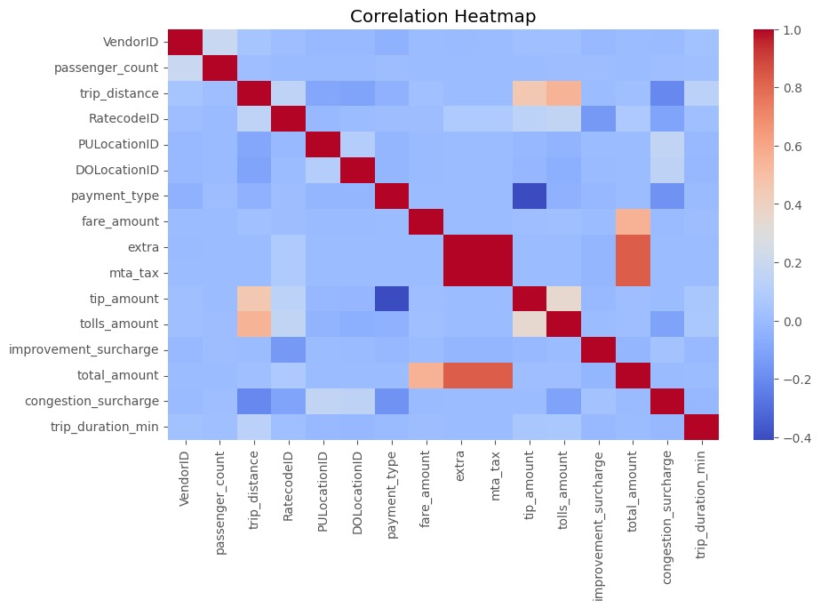

Slide 8
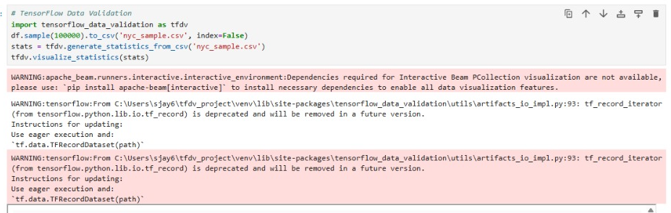

Slide 9
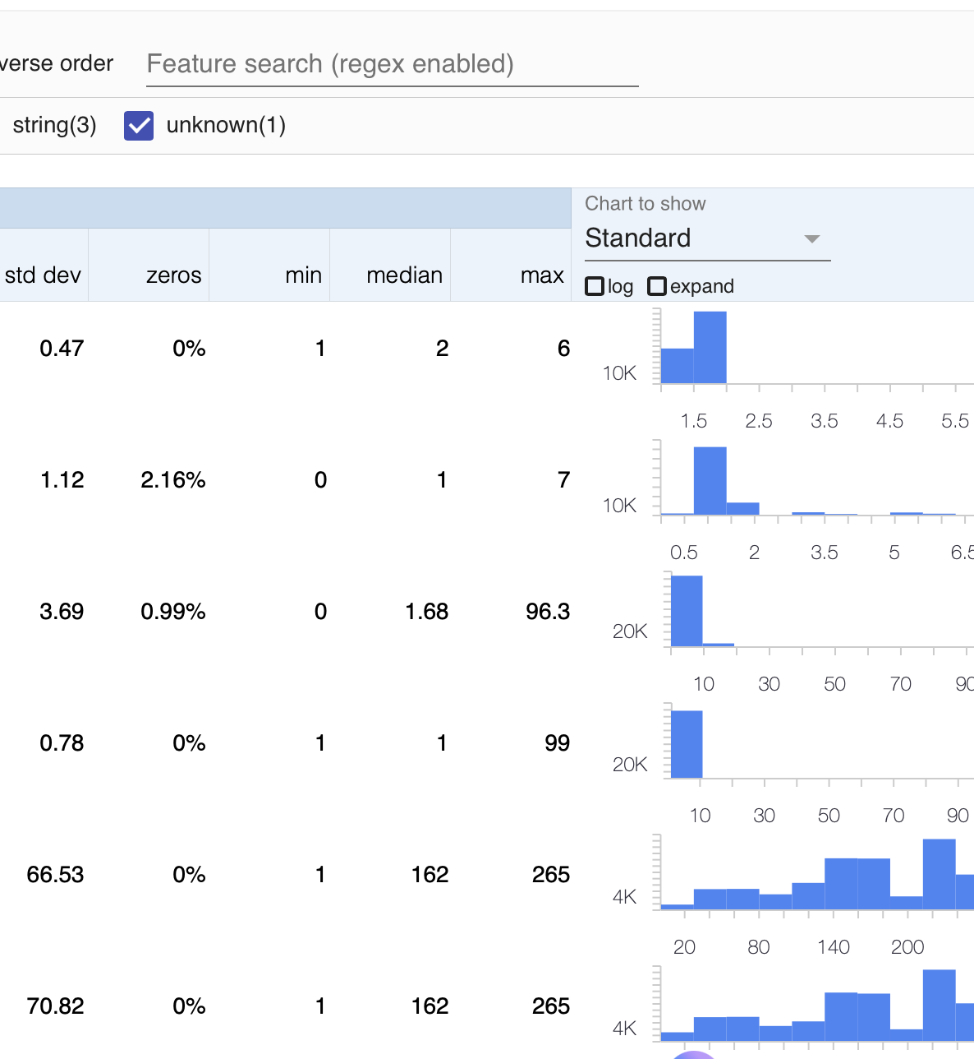
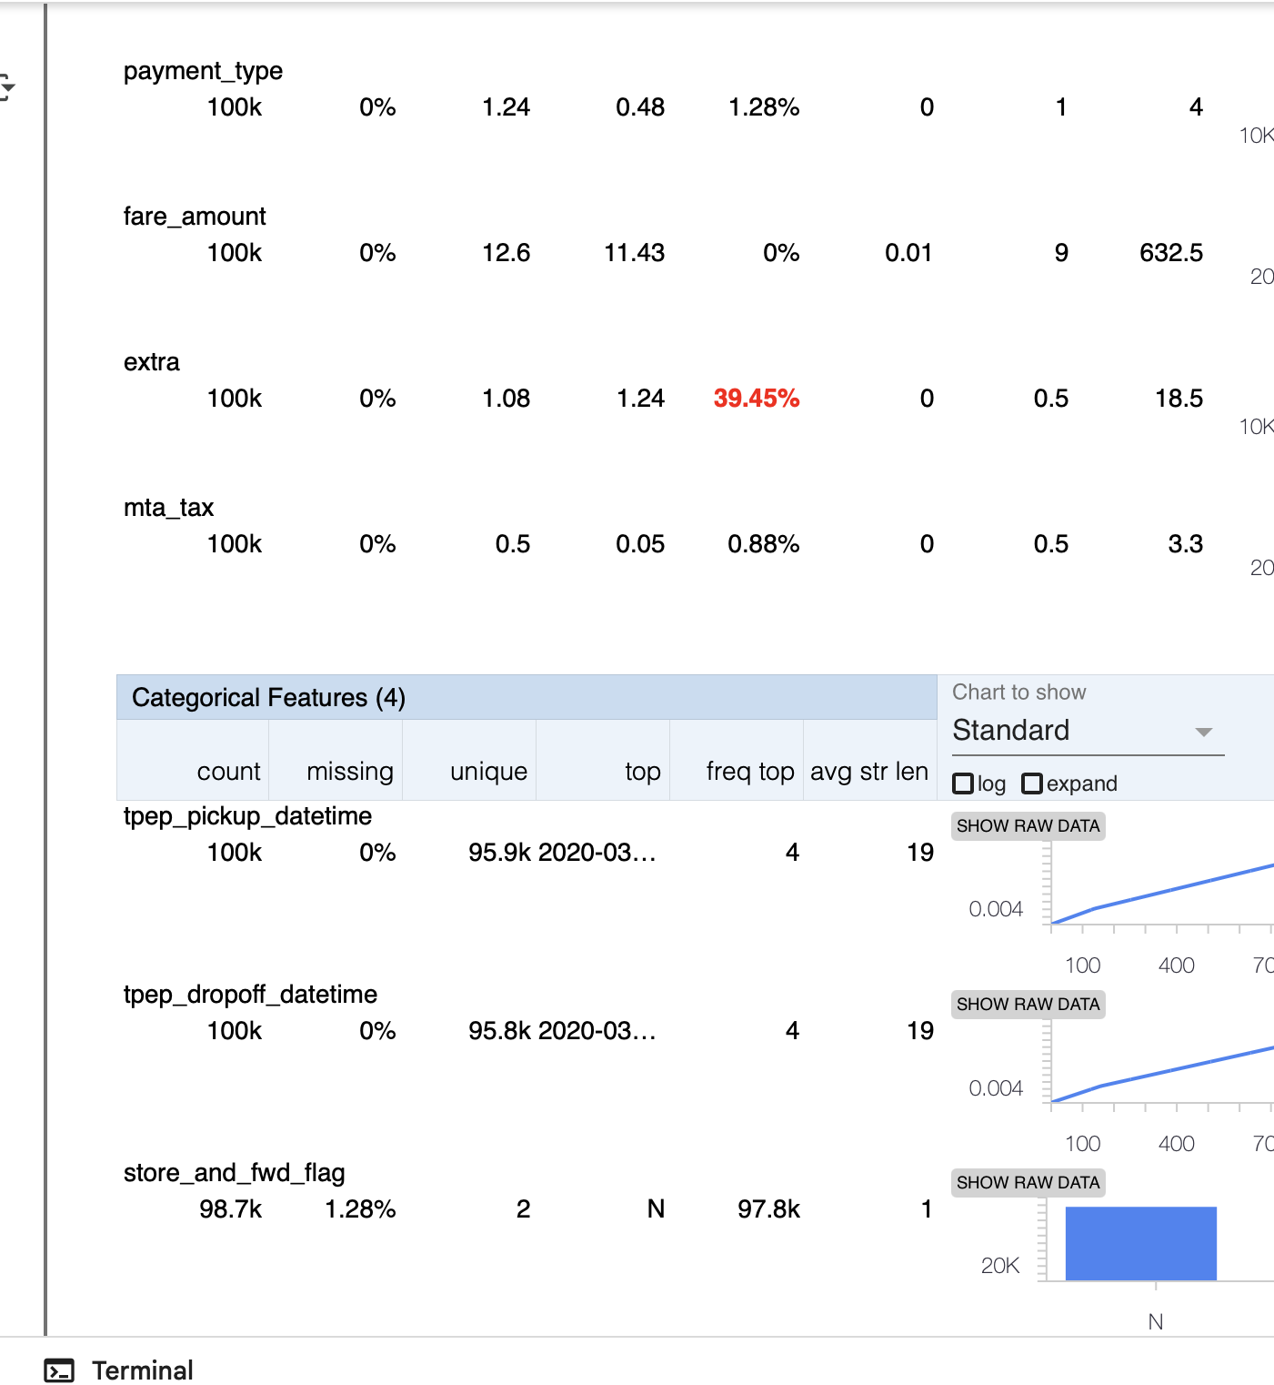

Slide 10
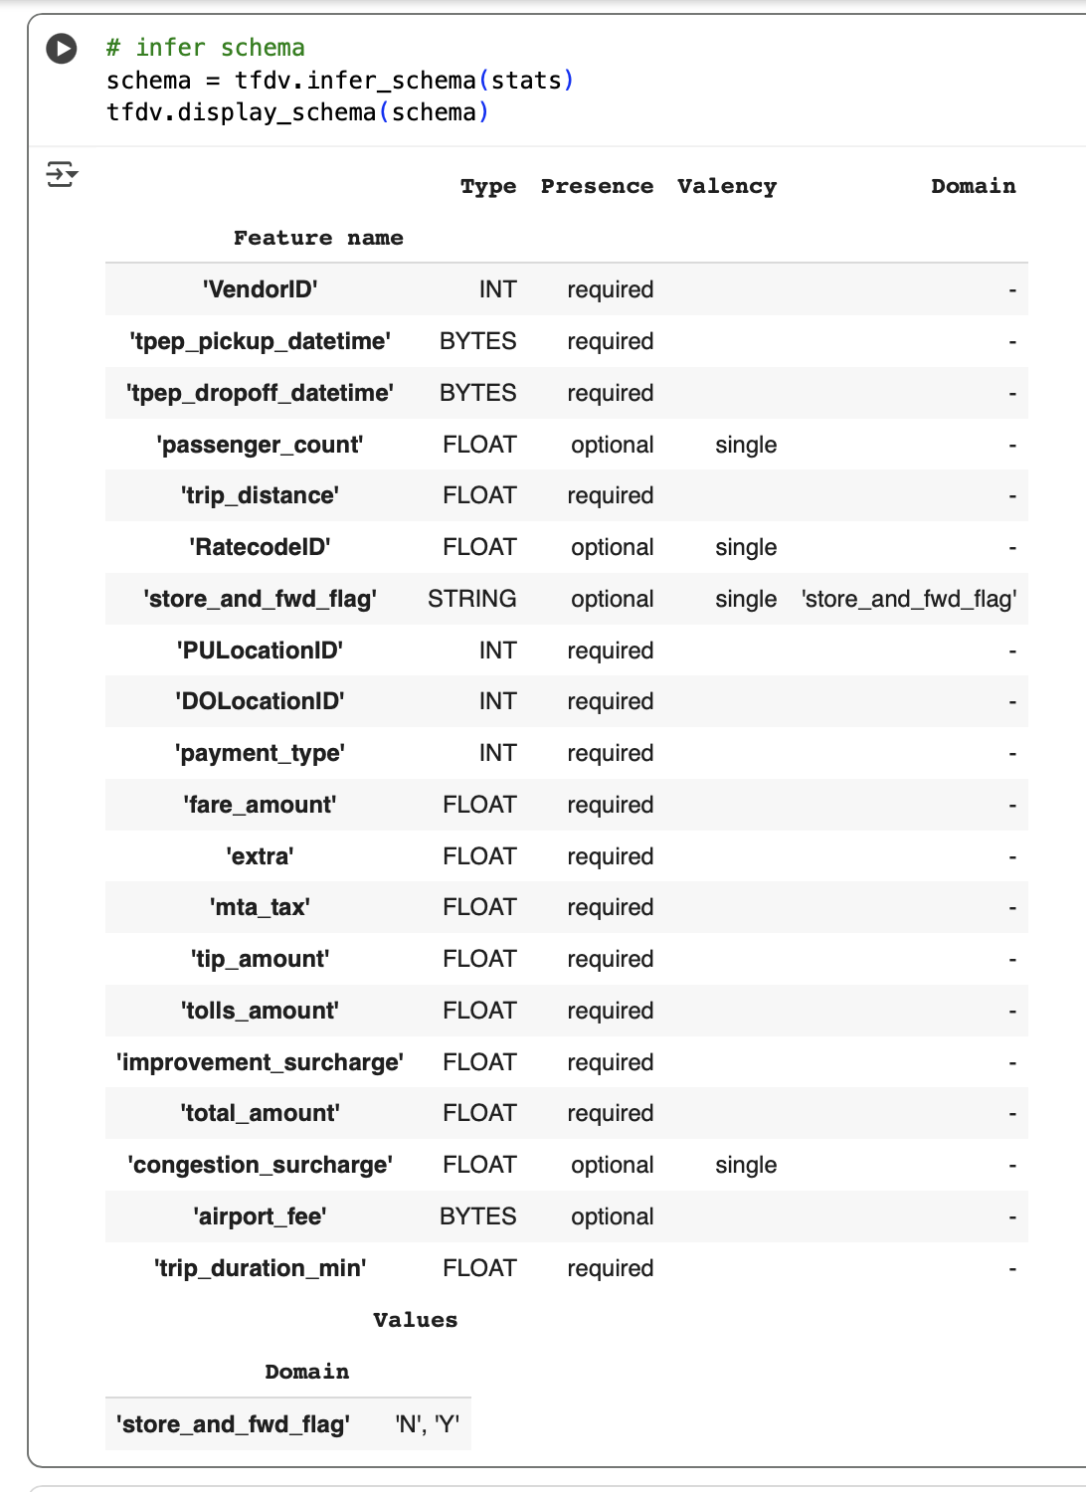

Slide 11
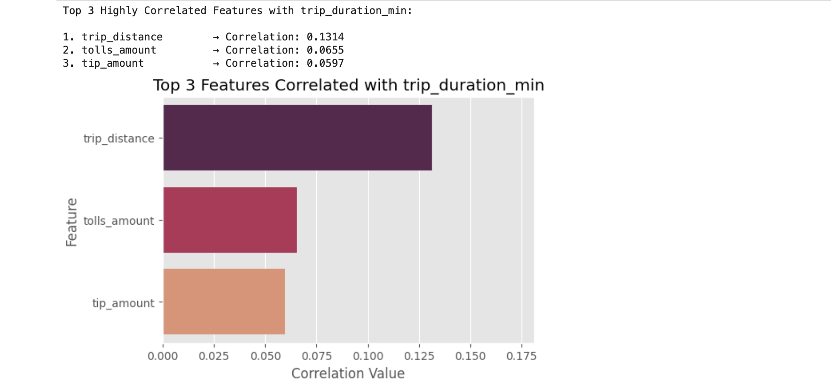

Slide 12
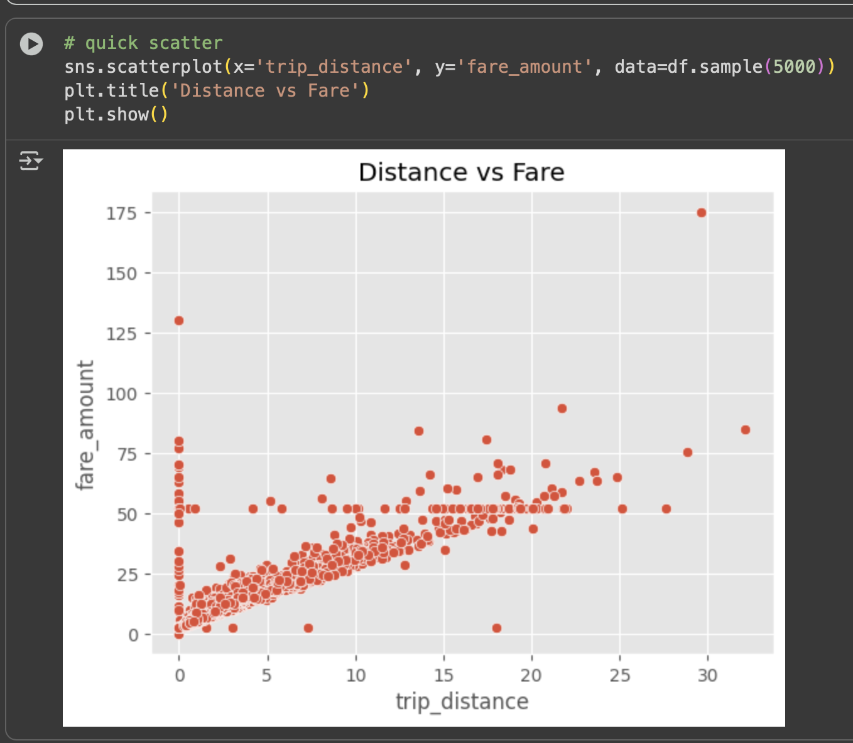

Slide 13
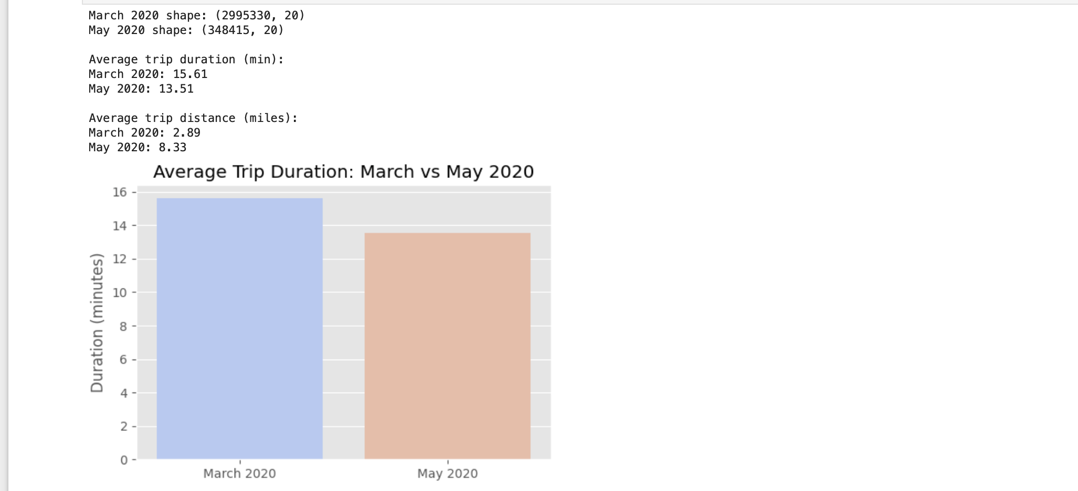
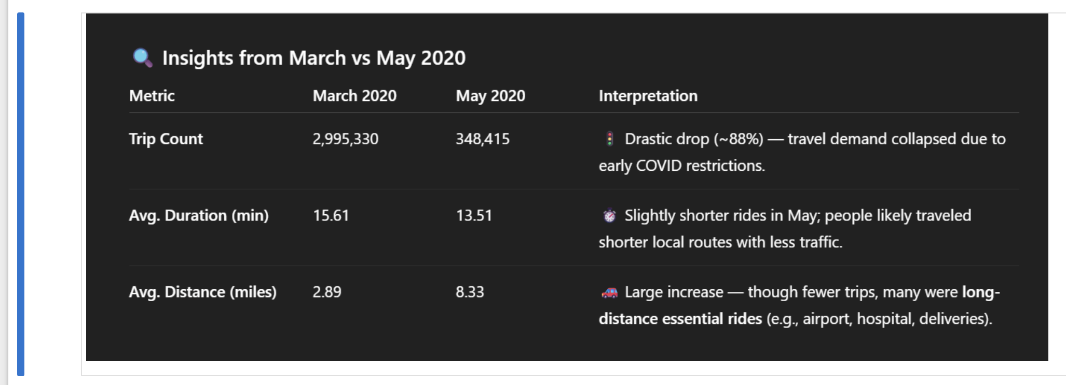

Slide 14
March vs May 2020 Comparison
March recorded ~3 million trips, while May had only ~0.35 million — a steep decline reflecting the pandemic’s early effect on NYC mobility.
Despite longer average distances (8.33 mi vs 2.89 mi), May trips took *less time* on average (13.5 min vs 15.6 min), showing faster traffic flow under reduced city congestion.
This shift highlights that post-March, ride behavior transitioned toward longer but faster essential trips — a defining characteristic of the new pandemic-era transportation pattern.

Slide 15
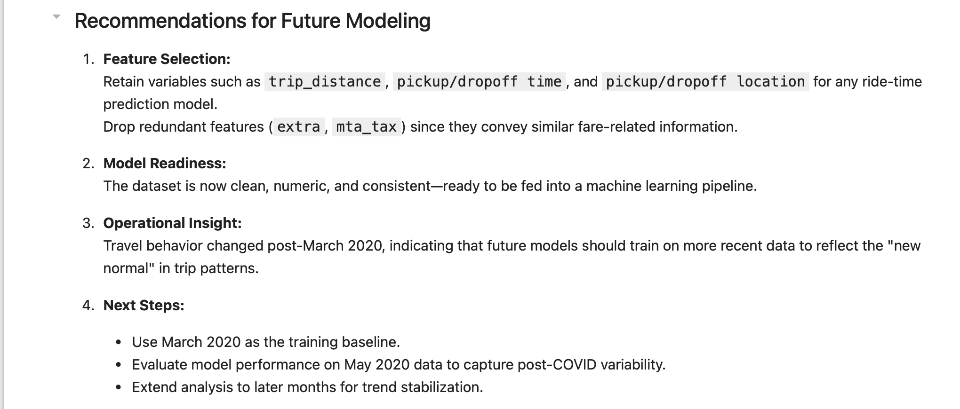

Slide 16
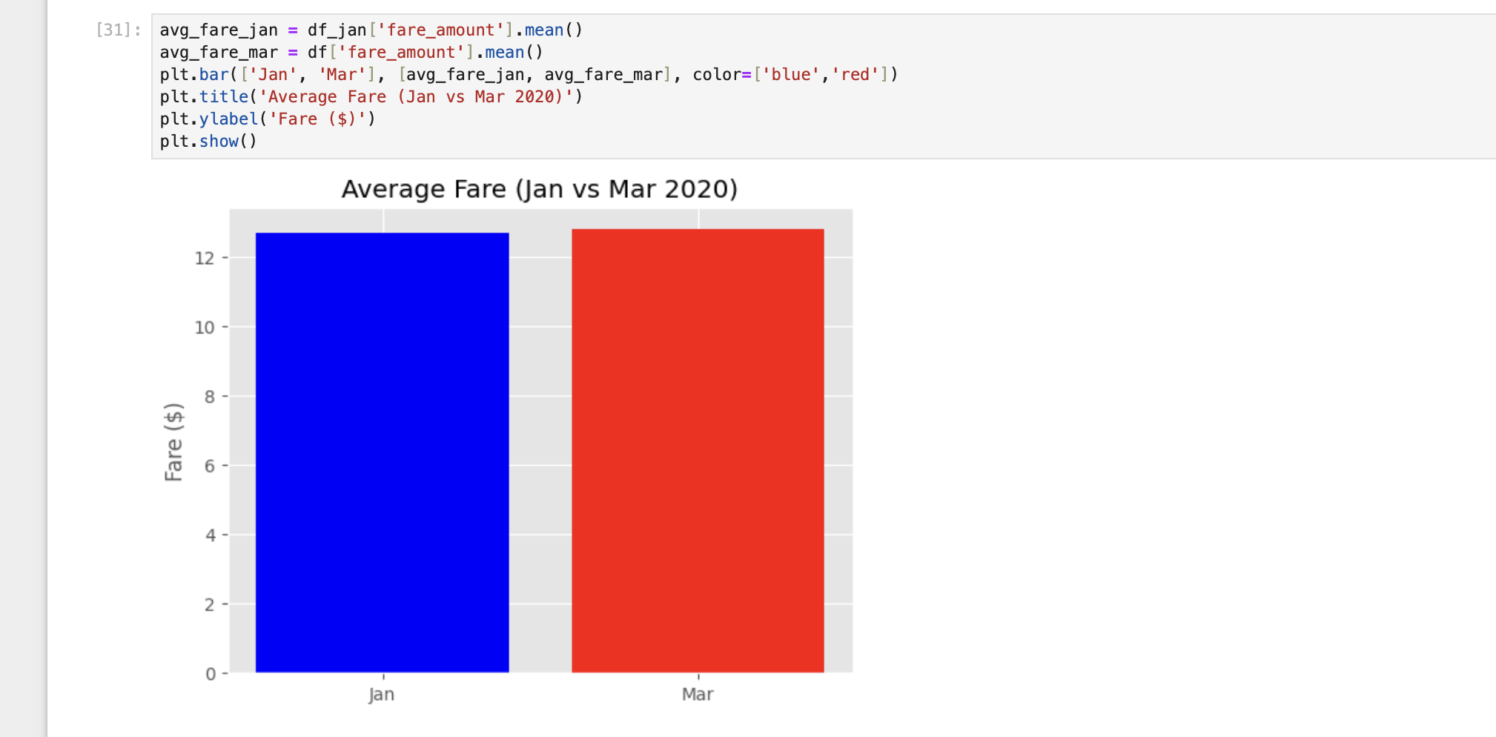

Slide 17


Slide 18
THANK YOU

